Slide 1

www.slammindixie.com

Slide 2

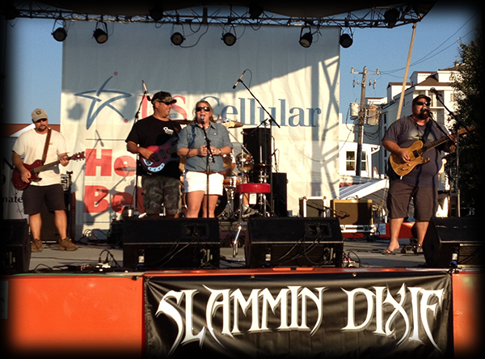
Slammin Dixie is a Country/Party Band based in Eastern North Carolina. Their catchy songs have the crowd singing at every show. Slammin Dixie plays a mix of new and classic country hits as well as some 80’s pop. With over 8 years of experience with local festivals, charity benefits, weddings, bike rallies, and club performances, Slammin Dixie is a band that will be long remembered around Eastern North Carolina.

Slide 3
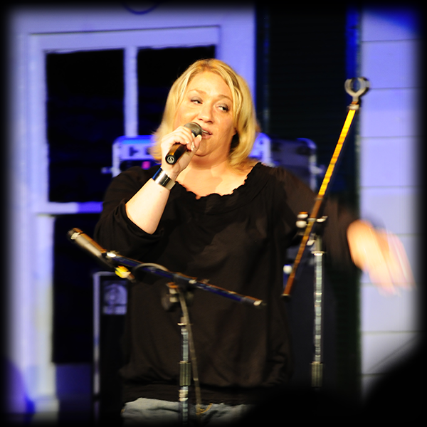
Rachel Reeves Ray is the lead singer for Slammin Dixie. Her powerful vocals are the cornerstone of the band. Years of experience on stage have gotten the attention of many aspiring, young vocalists. Her diversity in vocal performance ranges from 80’s Pop to Sad Country Songs.
Racel Reeves Ray, Swansboro NC

Slide 4
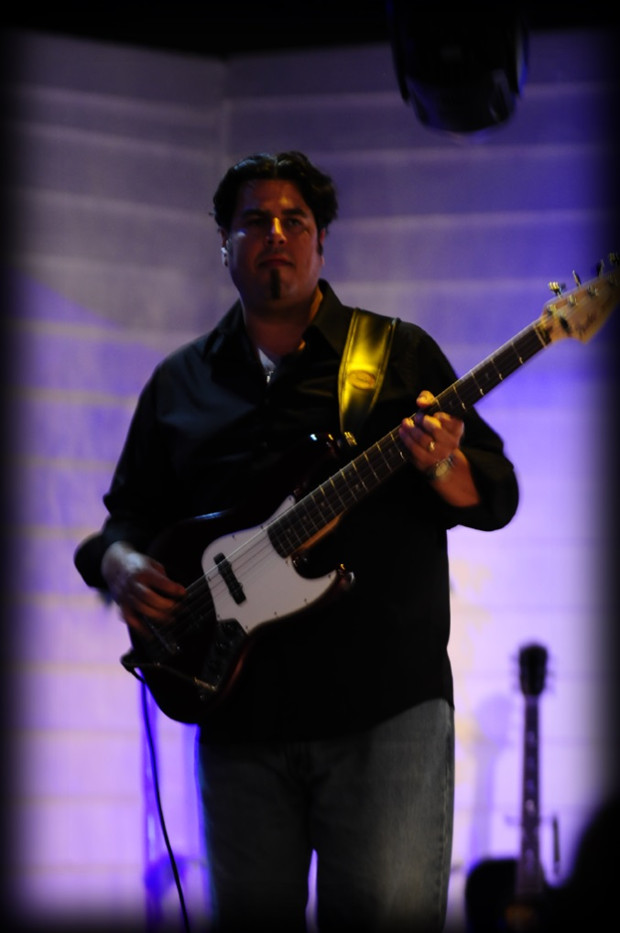
Tony Bello is the bass player and one of the founding members of Slammin Dixie. He has over 25 years experience with regional live music performances across the Eastern US. His diversity with many forms of music influence the signature sound of the band
Tony Bello, Goldsboro NC

Slide 5
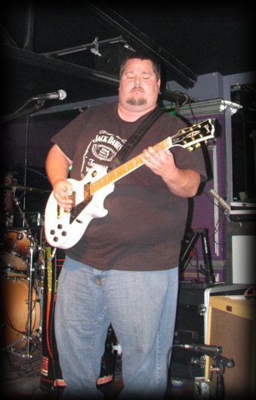
Johnny Howard is the lead guitar player and one of the founding members of Slammin Dixie. He has over 15 years experience with live country music performances across Eastern NC. His songwriting ability shines through many Slammin Dixie originals. His skilled lead ability takes notice from the best guitar players from all genre's.
Johnny Howard, Newport NC

Slide 6
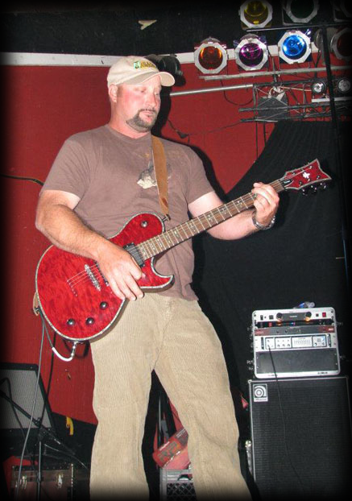
Danny Taylor is the rhythm guitar player of Slammin Dixie. He is very diverse with different musical styles and has strong country roots. His ability with song-writing arrangement is uncanny and he has a major influence in Slammin Dixie original music composition and production.
Danny Taylor, Newport NC

Slide 7
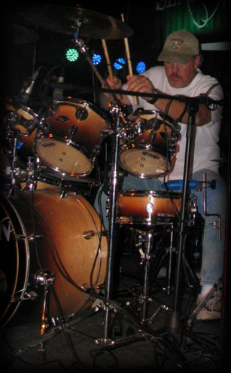
Larry Arnold is the drummer of Slammin Dixie. He is also an accomplished vocalist with distinct country influences. His legacy with live country music is evident within his family history. Larry is the backbone of Slammin Dixie and is the trigger for the unique sound of the band.
Larry Arnold, Newport NC

Slide 8
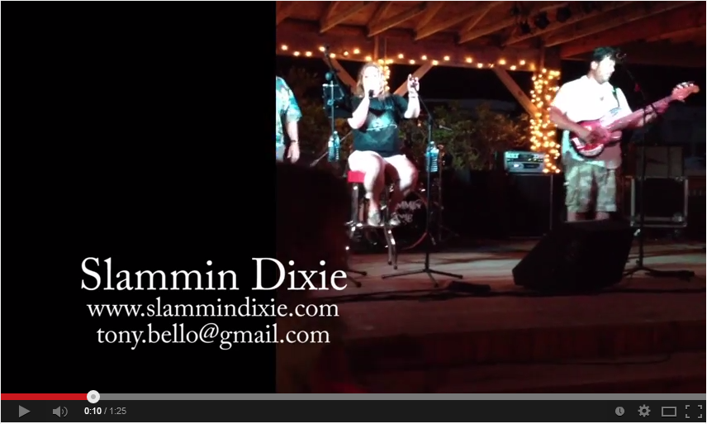
Videos
Slammin Dixie
Country Promo
2014
More Slammin Dixie media available:
http://www.slammindixie.com

Slide 9
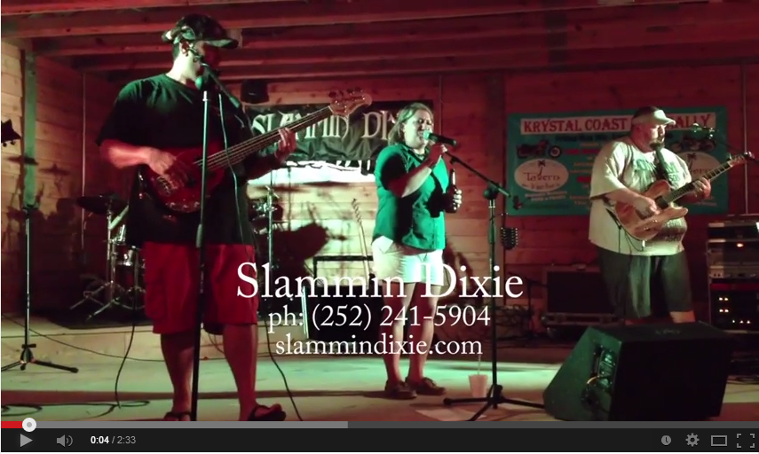
Videos
Slammin Dixie
80’s Promo
2014
More Slammin Dixie media available:
http://www.slammindixie.com

Slide 10
Set List
ALWAYS ALRIGHT Alabama Shakes
BETTER DIG TWO The Band Perry
BLUE MOON OF KENTUCKY Patsy Cline
THE BREEZE Lynyrd Skynyrd
CHICKEN TRUCK John Anderson
COPPERHEAD ROAD Steve Earle
DON’T CLOSE YOUR EYES Keith Whitley
DON’T STOP BELIEVIN’ Journey
DOWNTOWN Lady Antebellum
EYE OF THE TIGER Survivor
FAMILY TRADITION Hank Williams Jr
THE FIREMAN George Strait
FOLSOM PRISON BLUES Johnny Cash
GIVE ME ONE REASON Tracy Chapman
GOOD HEARTED WOMAN Waylon Jennings & Willie Nelson
GOOD OL BOYS Waylon Jennings
GUNPOWDER AND LEAD Miranda Lambert
HANK DONE IT THAT WAY Waylon Jennings
HELP ME MAKE IT THRU NIGHT Sammi Smith
HONKY TONK WOMEN The Rolling Stones
HE STOPPED LOVING HER TODAY George Jones
HELL ON HEELS Pistol Annies
HIT ME WITH YOUR BEST SHOT Pat Benatar
KEEP YER HANDS TO YOURSELF Georgia Satellites
LONG HAIRED COUNTRY BOY Charlie Daniels Band
MAMA’S BROKEN HEART Miranda Lambert
MARGARITAVILLE Jimmy Buffet
MARY JANE’S LAST DANCE Tom Petty and the Heartbreakers
MUSTANG SALLY Wilson Pickett
NEON MOON Brooks & Dunn
NEVER CALL ME BY MY NAME David Alan Coe
OLD HABITS Hank Williams Jr
PONTOON Little Big Town
PRIDE AND JOY Stevie Ray Vaughn
PROUD MARY Tina Turner
RIGHT WHERE I NEED TO BE Gary Allan
THE ROCK Lee Roy Parnell
ROCKIN’ WITH THE RHYTHM RAIN The Judds
SIN WAGON Dixie Chicks
STAY HERE DRINK Merle Haggard
SUMMER OF ’69 Bryan Adams
TROPICAL DEPRESSION Alan Jackson
WALK SOFTLY ON HEART OF MINE Kentucky Headhunters
WANTED DEAD OR ALIVE Bon Jovi
THE WHISKEY AINT WORKIN Travis Tritt & Marty Stewart
WHISKEY BENT AND HELL BOUND Hank Williams Jr.
WHITE LIAR Miranda Lambert
WONDERFUL TONIGHT Eric Clapton
WORKIN MAN BLUES Merle Haggard
YARD SALE Sammy Kershaw
YOUR LOVE The Outfield

Slide 11
References
NC Seafoood Festival Morehead City, NC Heroes Mount Olive, NC
NC Motorsports Festival Cape Carteret, NC White Oak Shores RV Park Stella, NC
Riverwalk Festival Jacksonville, NC VFW Post 8986 Newport, NC
Emerald Isle Bike Rally Emerald Isle, NC Moose Lodge Swansboro, NC
Maynard’s Seven Springs, NC Flatwoods Hubert, NC
Tarheel Opry House Jacksonville, NC Hard Hat Lounge Aurora, NC
The Diamond Club New Bern, NC Red Barn Hubert, NC
Cadillac Ranch Longview, TX Jean’s Place Havelock, NC
Jack’s Waterfront Bar Morehead City, NC Boonedock’s Peletier, NC
Emerald Club Emerald Isle, NC Harbor Site Bar Sneads Ferry, NC
Grandover Resort Greensboro, NC Coastal Plains Raceway Jacksonville, NC
Carteret County Fair Newport, NC VFW Post 8689 Newport, NC
Tarheel Variety Theatre Chocowinity, NC Scallywags Cedar Point, NC
Easy Eddie’s Huntersville, NC Cedar Point Tavern Cedar Point, NC
Swansboro Yacht Club Swansboro, NC Timeout Tavern Newport, NC
Jo Jo’s Sports Bar Swansboro, NC Gus’ Country Rock Club Jacksonville, NC
The Dive Peletier, NC Creekside Bar Bear Creek, NC
Howard’s Pub Ocracoke, NC Paddy’s Pub Emerald Isle , NC
Cripple Creek Roadhouse New London, NC VFW 9960 Swansboro, NC
Señor Dick's Warehouse Cape Carteret, NC Rockland Irish-American Center Blauvelt, NY
Whiskey Café Lyndhurst, NY Best Western Regency House Pompton Plains, NJ

Slide 12




Equipment
No venue is too small or too large. Slammin Dixie owns a 10,000 watt PA sound system and Lights sufficient for the largest clubs as well as compact systems for quaint facilities. Pricing is dependent on travel distance, time slot, and PA usage.
Band Contact
Tony Bello ph: 252.241.5904
315 Rollingwood Dr. tony.bello@gmail.com
Newport NC, 28570
www.slammindixie.com

